Slide 1
Software Maintenance Unit-V
Prepared by: Neha Tripathi

Slide 2
Software Maintenance
Software Maintenance is the process of modifying a software product after it has been delivered to the customer. The main purpose of software maintenance is to modify and update software application after delivery to correct faults and to improve performance.
Need for Maintenance – Software Maintenance must be performed in order to:
- Correct faults.
- Improve the design.
- Implement enhancements.
- Interface with other systems.
- Accommodate programs so that different hardware, software, system features, and telecommunications facilities can be used.
- Migrate legacy software.
- Retire software.

Slide 3
Types of software maintenance
There are basically four types of software maintenance. These are:
• Corrective maintenance :
Corrective maintenance of a software product is necessary to rectify the bugs observed while the system is in use.
• Adaptive maintenance :
A software product might need maintenance when the customers need the product to run on new platforms, on new operating systems, or when they need the product to interface with new hardware or software.
• Perfective maintenance :
A software product needs maintenance to support the new features that users want it to support, to change different functionalities of the system according to customer demands, or to enhance the performance of the system.
Preventive maintenance: This type of maintenance includes modifications and updations to prevent future problems of the software. It goals to attend problems, which are not significant at this moment but may cause serious issues in future.

Slide 4
Software reverse engineering
Software Reverse Engineering is the process of recovering the design and the requirements specification of a product from an analysis of it’s code. Reverse Engineering is becoming important, since several existing software products, lack proper documentation, are highly unstructured, or their structure has degraded through a series of maintenance efforts.
Why Reverse Engineering?
- Providing proper system documentation.
- Recovery of lost information.
- Assisting with maintenance.
- Facility of software reuse.
- Discovering unexpected flaws or faults.

Slide 5
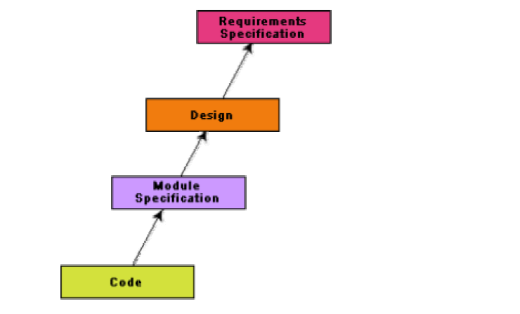
A process model for reverse engineering

Slide 6
Software maintenance process models
Two broad categories of process models for software maintenance can be proposed.
The first process model is preferred for projects involving small reworks where the code is changed directly and the changes are reflected in the relevant documents later.
The second process model for software maintenance is preferred for projects where the amount of rework required is significant. This approach can be represented by a reverse engineering cycle followed by a forward engineering cycle. Such an approach is also known as software reengineering.

Slide 7
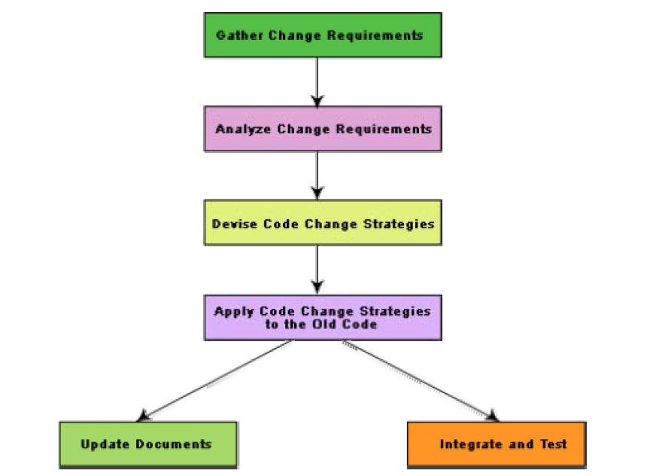
Maintenance process model 1

Slide 8
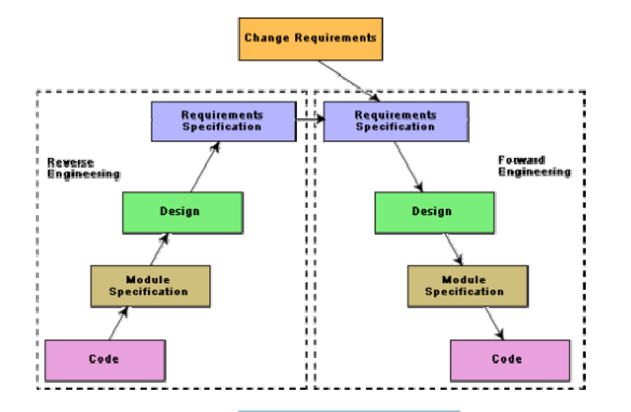
Maintenance process model 2

